Slide 1


SMART INDIA HACKATHON 2025
Problem Statement ID – SIH25041
Problem Statement Title - AI-Driven Unified Data Platform for Oceanographic, Fisheries and molecular biodiversity Insights.
Theme – Renewable / Sustainable Energy
PS Category - Software
Team ID - 72973
Team Name - The Coral Coders

Slide 2
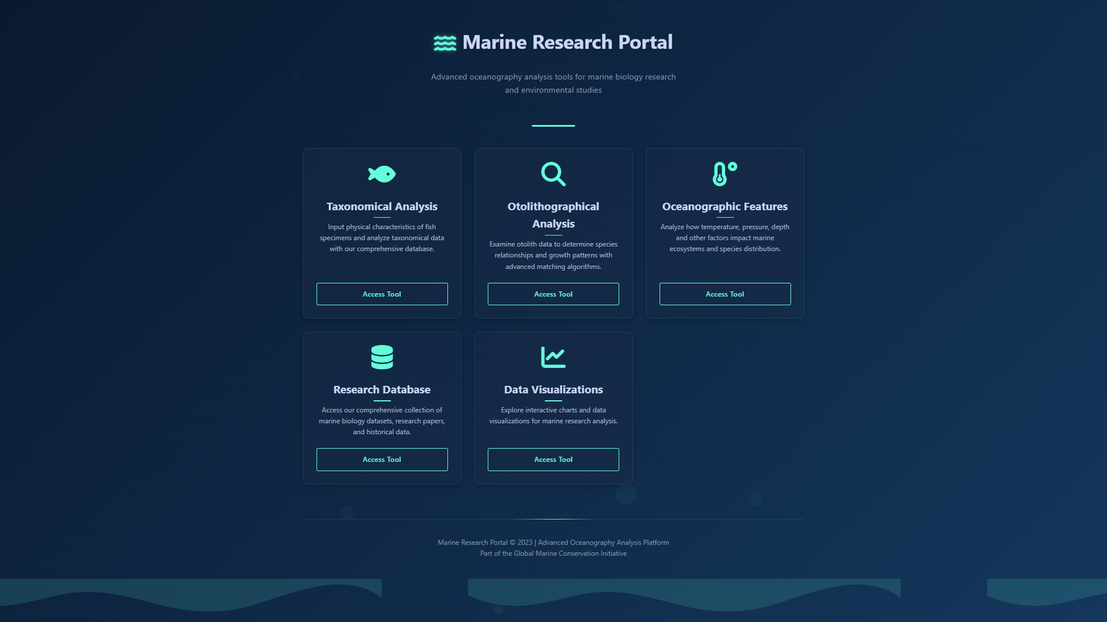





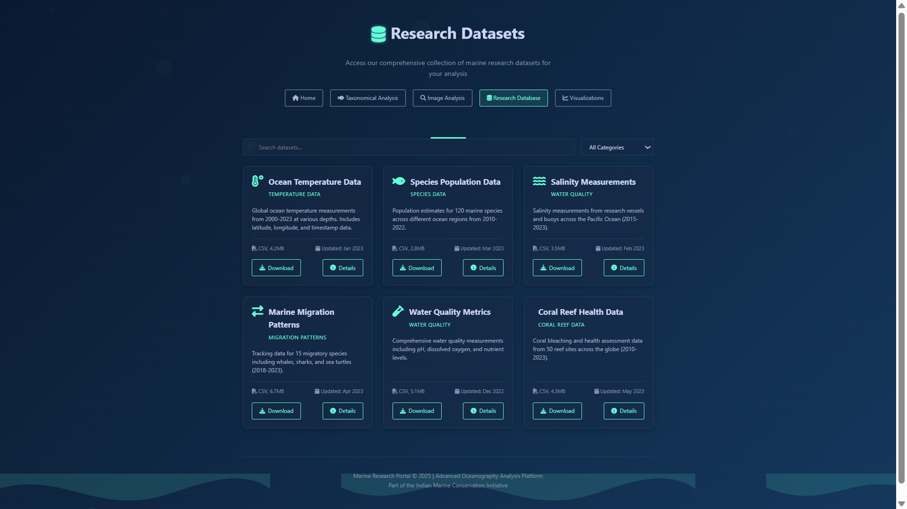

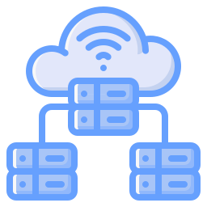



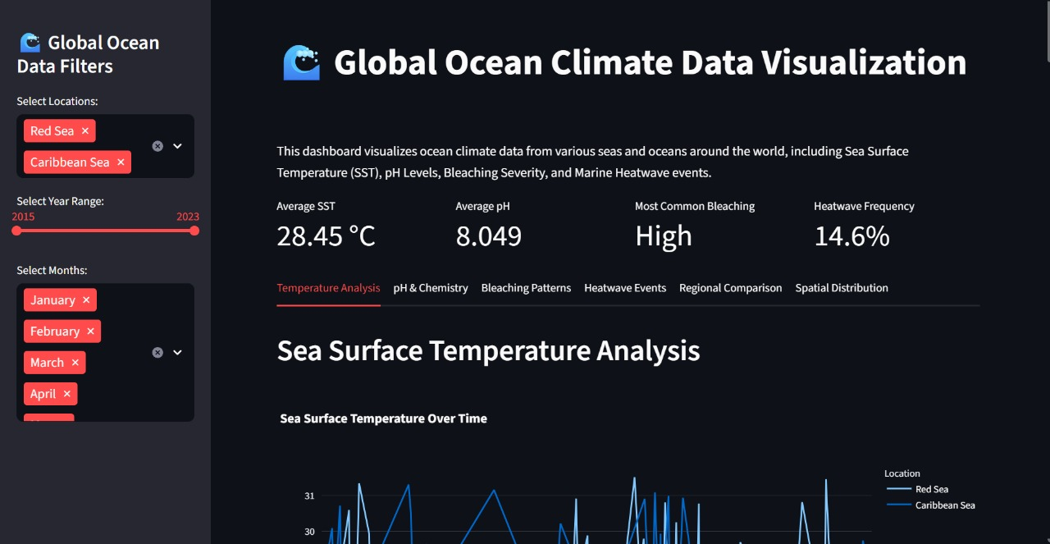



A Unified Framework for Marine Ecosystem Assessment
THE CORAL CODERS
Solution :
An AI-driven unified data platform that integrates heterogeneous oceanographic, fisheries, and molecular data to enable cross-disciplinary analysis and enhance real-time decision-making for sustainable marine ecosystem management.
Flowchart :
UI/UX Design :
Data
Database
Key Features :
Breaks Down Data Silos
Merges ocean, fish, DNA, and morphology data into a unified system for cross-disciplinary insights.
Automated Data Pipelines
Modular pipelines auto-ingest, standardize, and tag data to ensure quality and speed.
AI-Powered Insights
Predicts fish stock trends and finds ecosystem-biodiversity correlations for conservation.
Specialized Modules
Interactive otolith study, taxonomy classification, fast species ID, and eDNA-based biodiversity mapping.
Automated data pipeline
Cloud Infrastructure
Specialized Modules
End Users
Dashboard

Slide 3
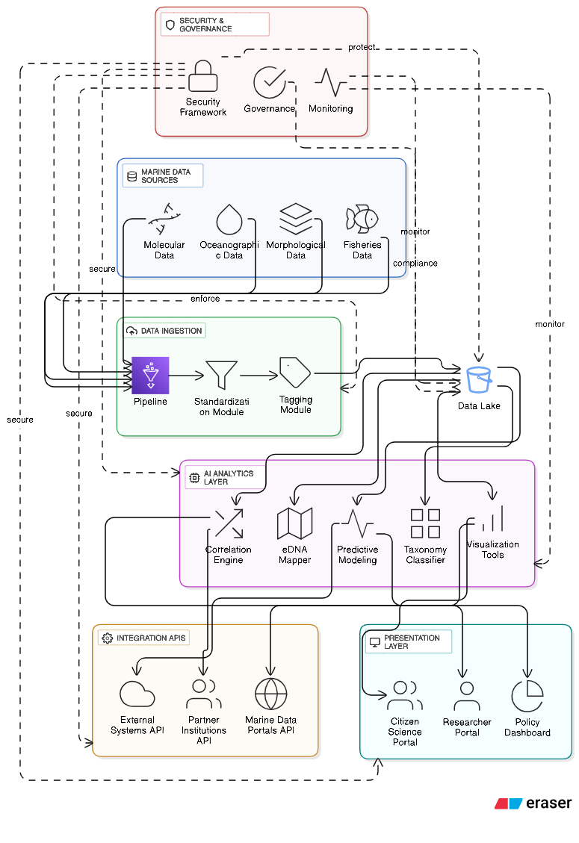
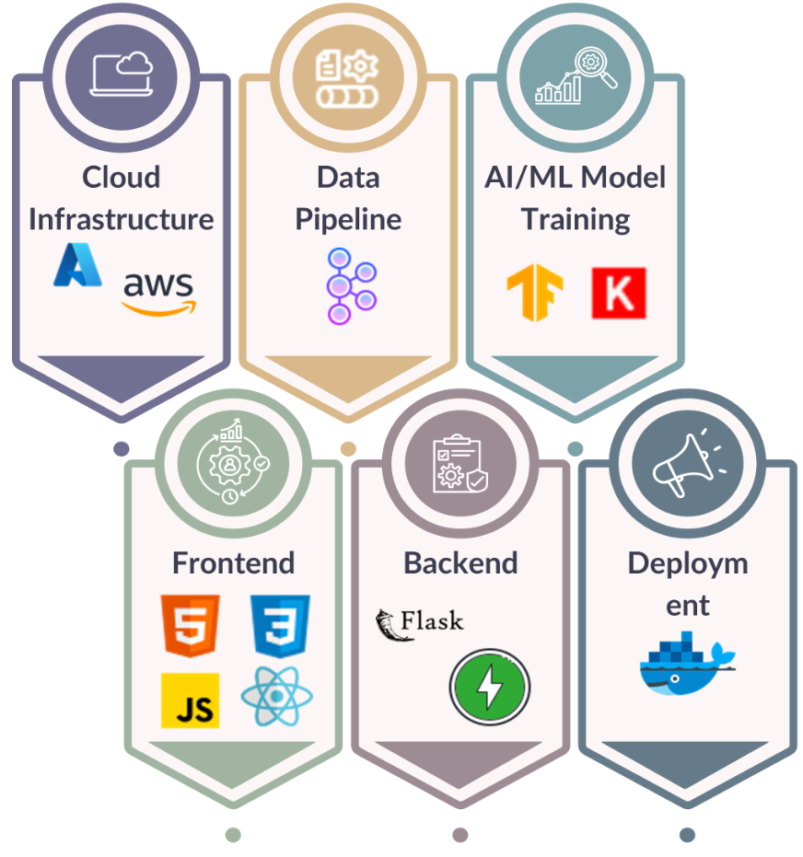
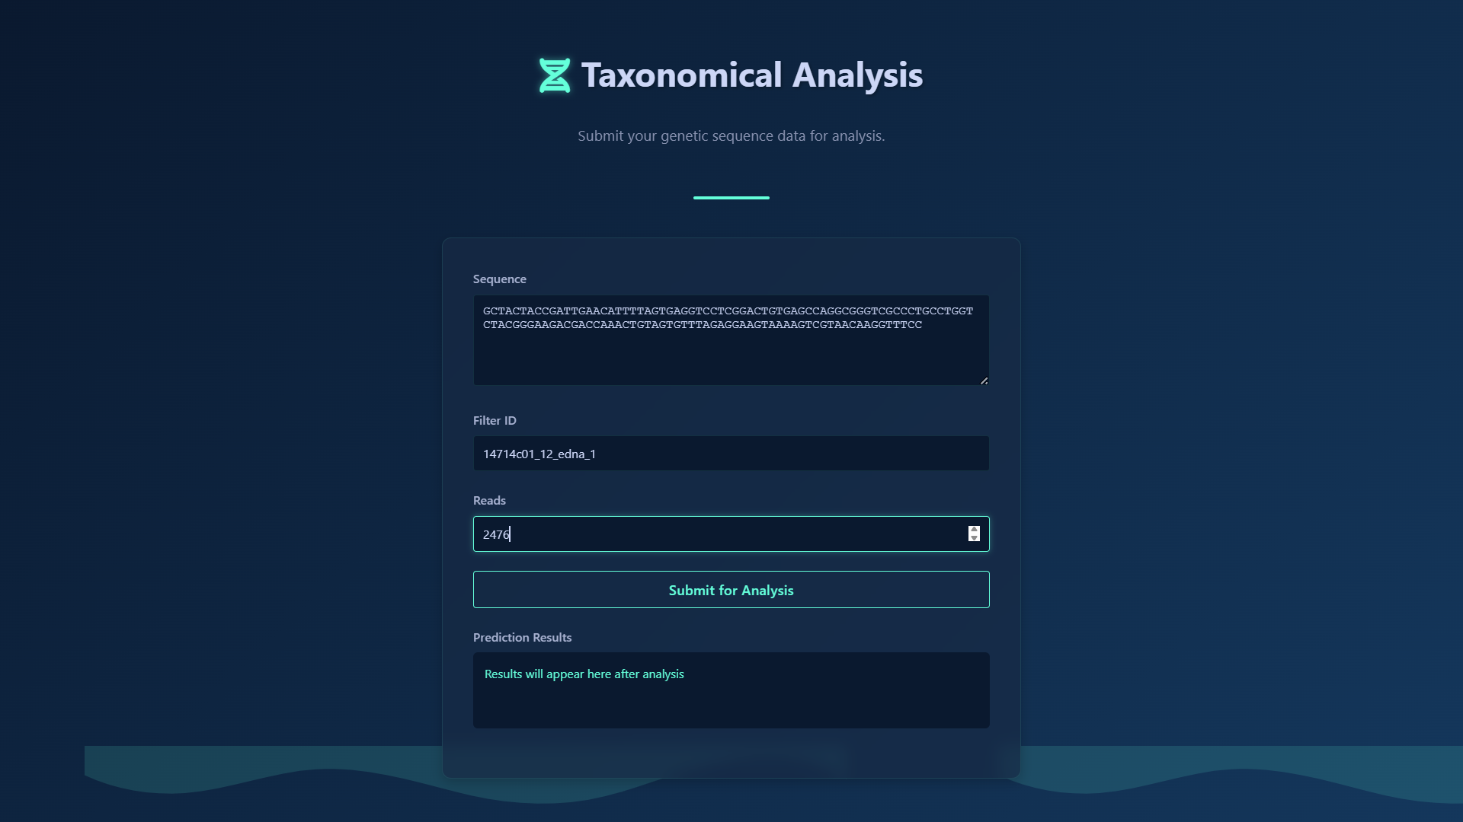
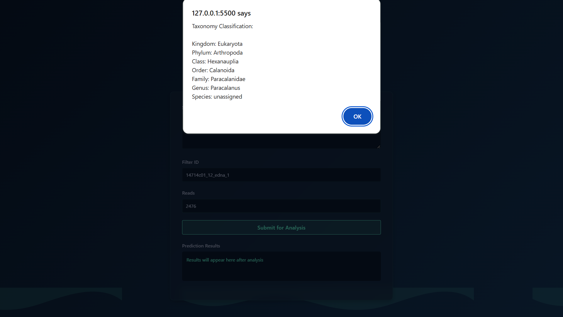
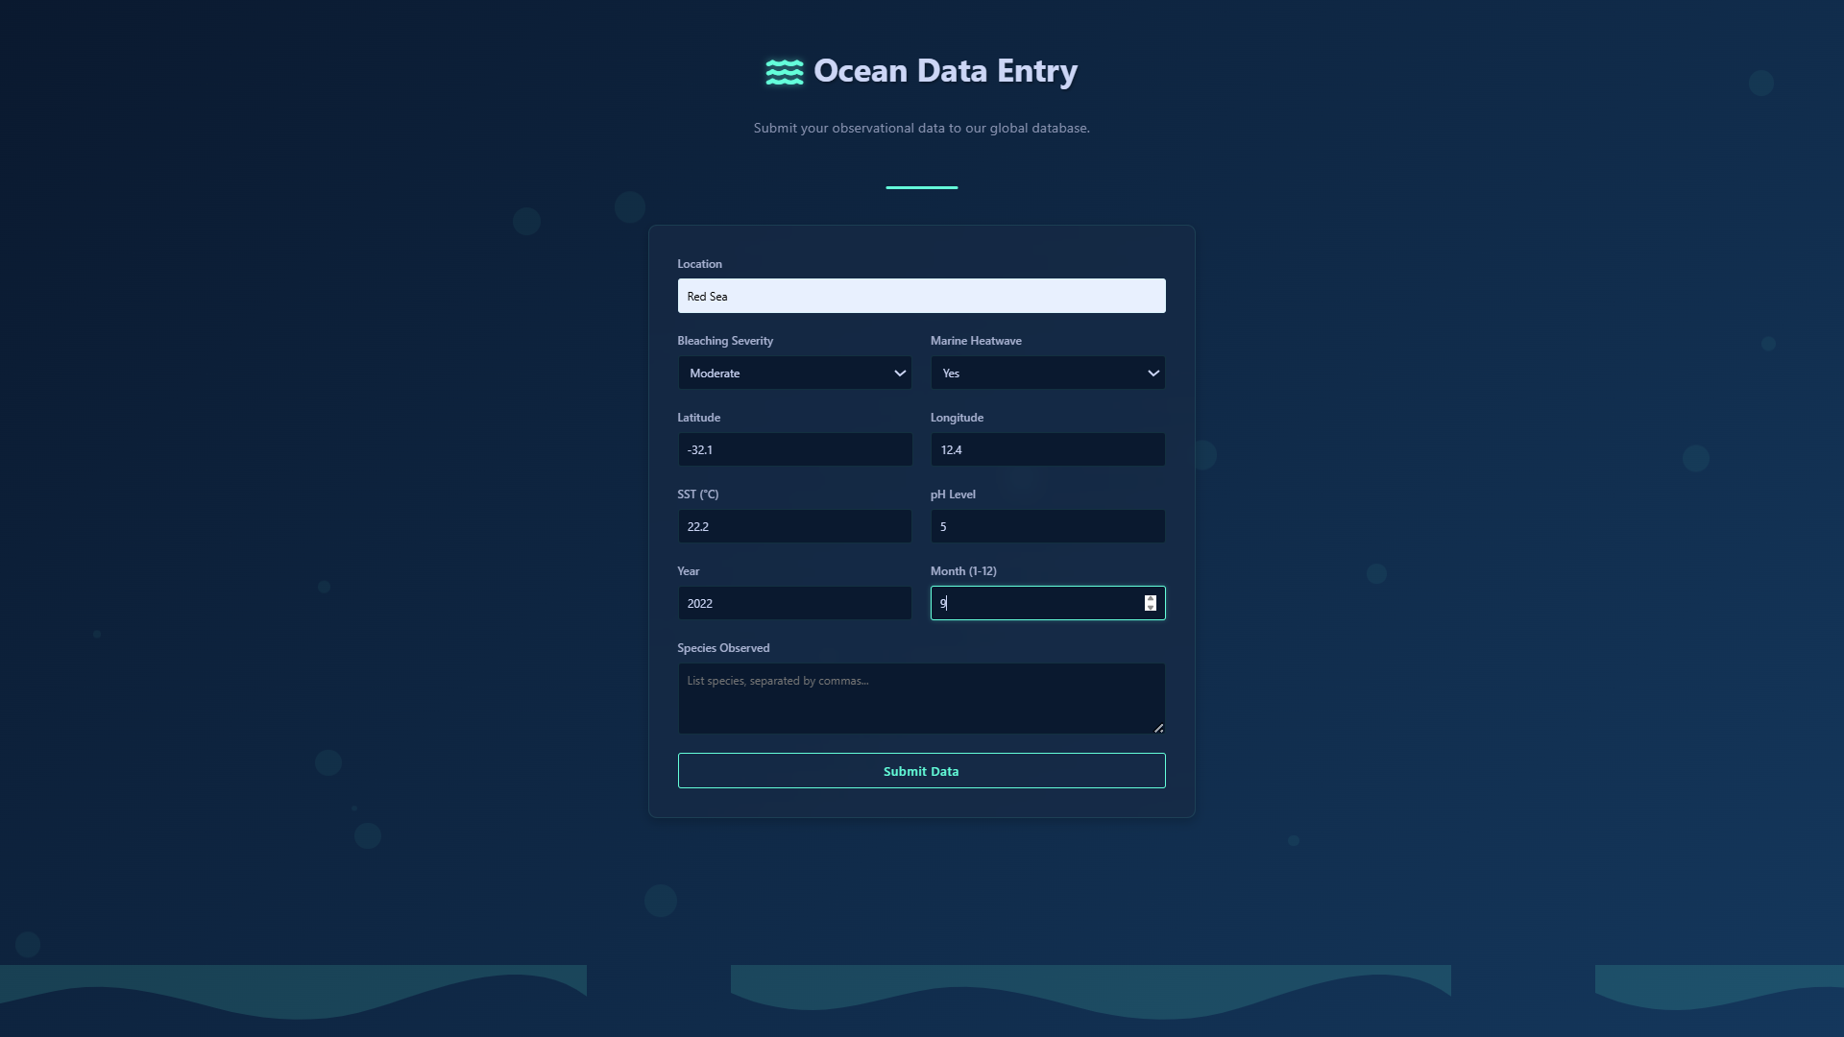
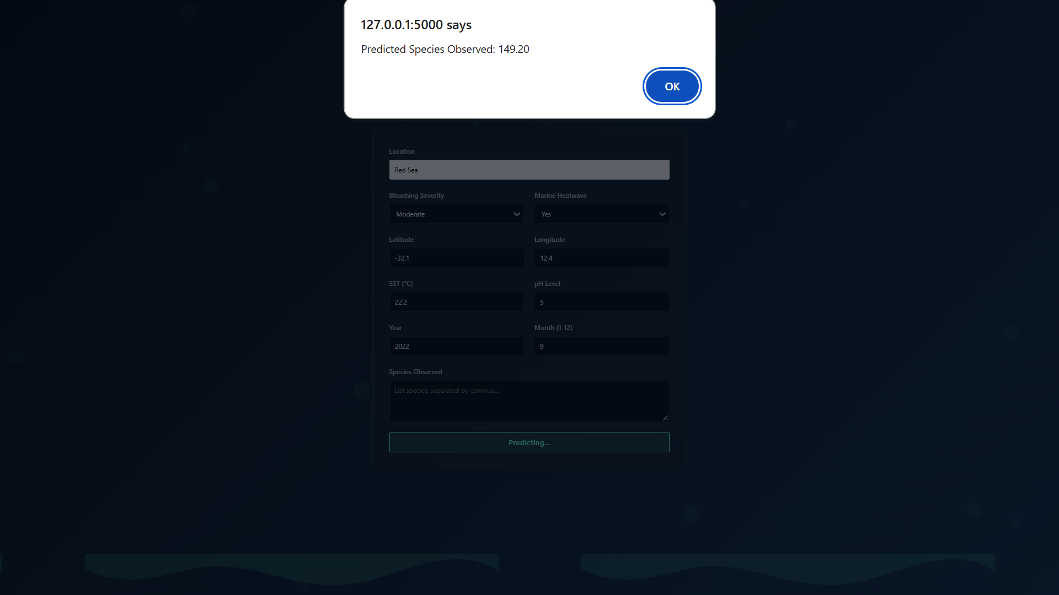
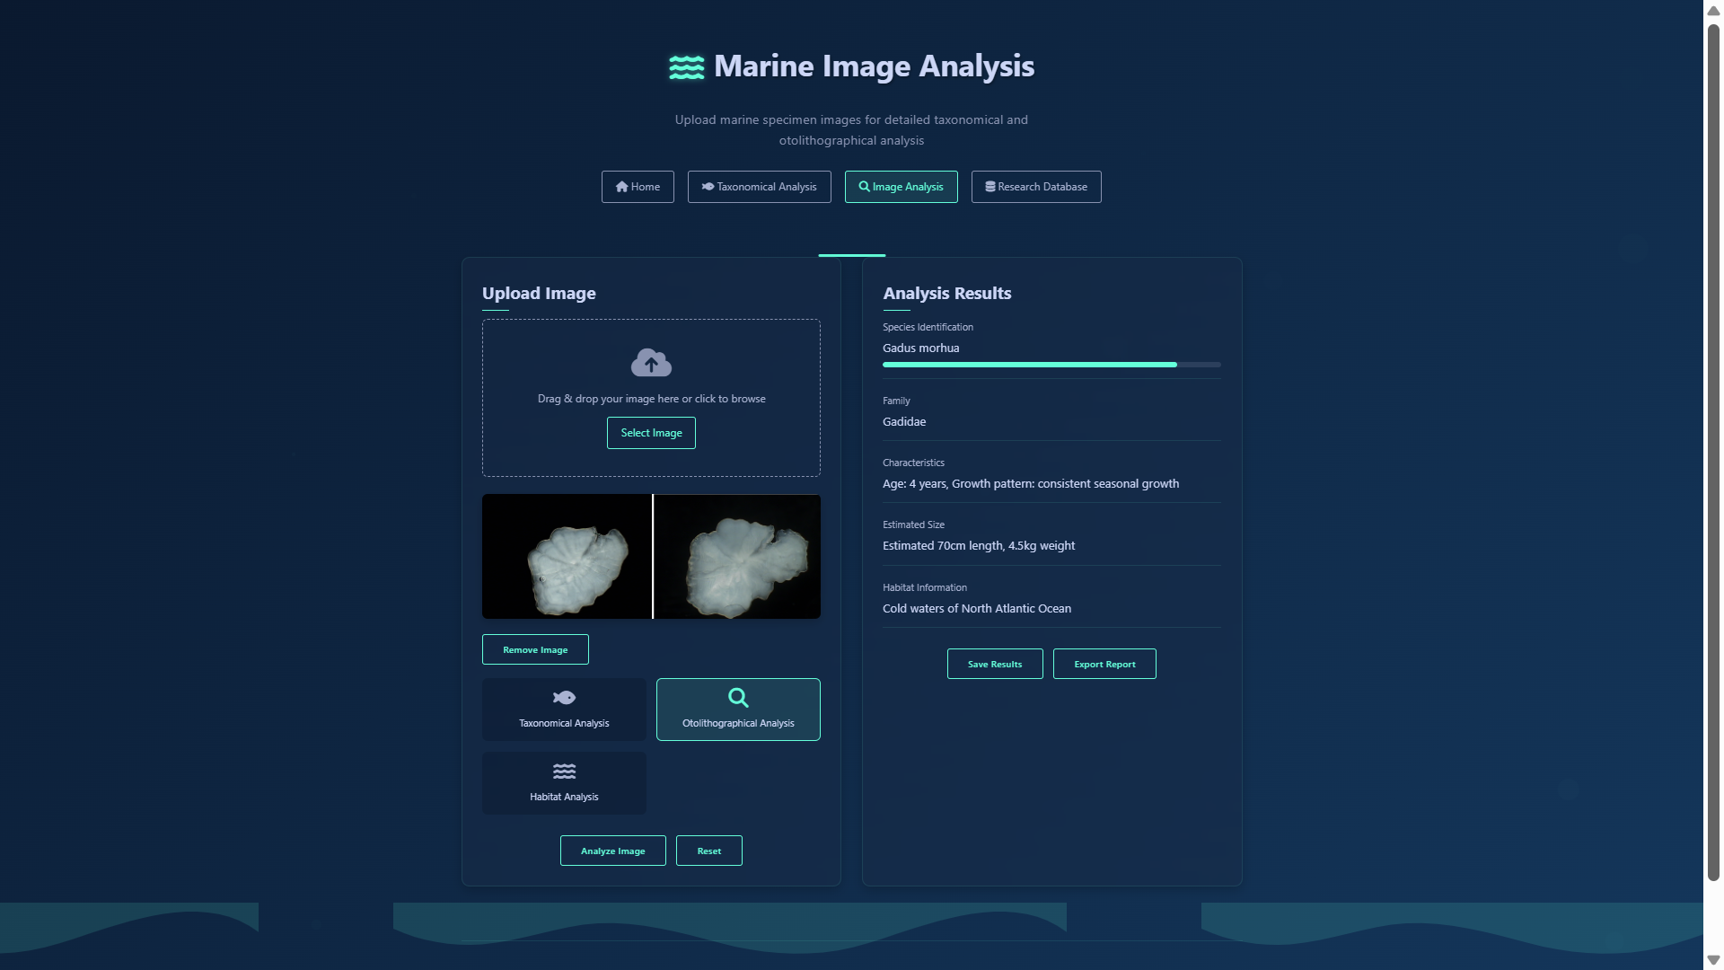
TECHNICAL APPROACH
THE CORAL CODERS
System Architecture :
Technical Stack :
UI/UX Design :
Methodology :
Adopting Agile Methodology enabling iterative, continuous and flexible for evolving project requirements.

Slide 4
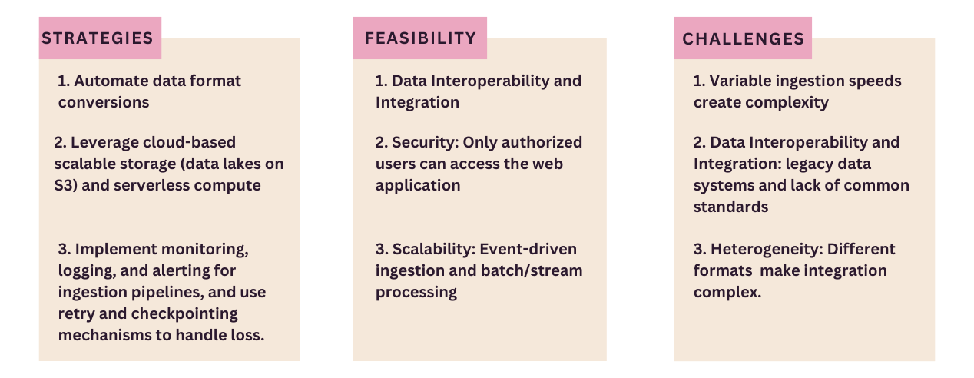
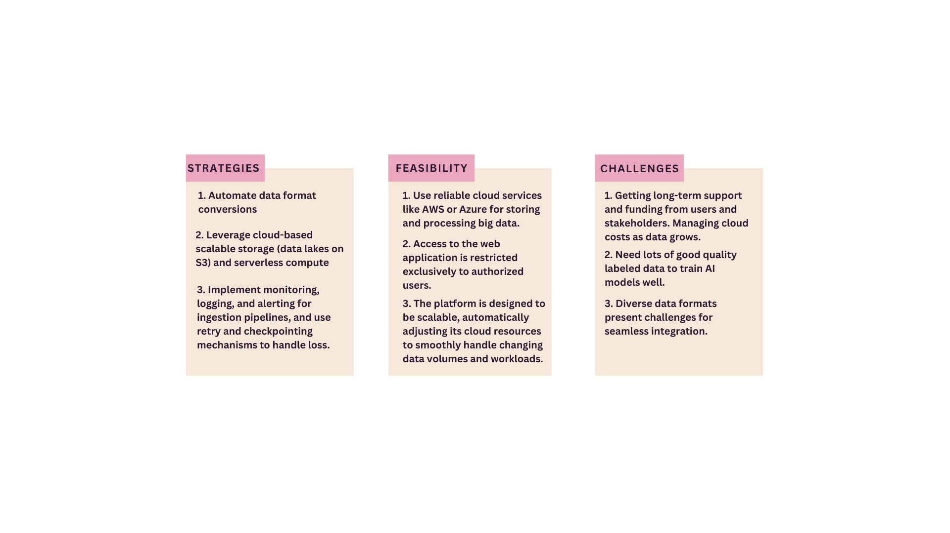
FEASIBILITY AND VIABILITY
THE CORAL CODERS

Slide 5
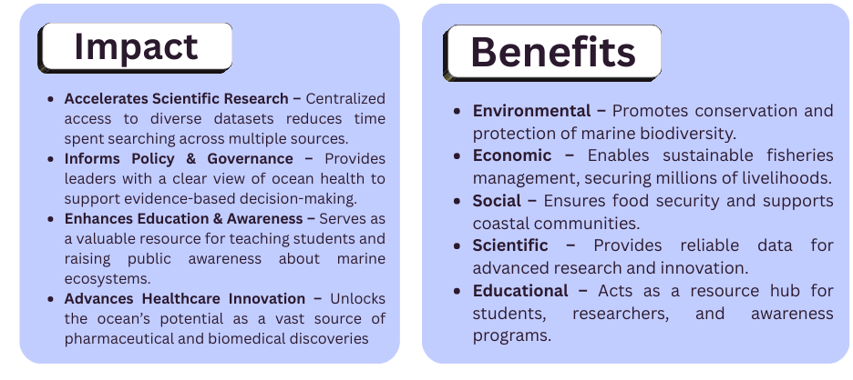
IMPACT AND BENEFITS
Impact
THE CORAL CODERS
Impact

Slide 6
RESEARCH AND REFERENCES
THE CORAL CODERS
https://www.cmlre.gov.in/ - Center of Marine Living Resources and Ecology.
https://indobis.in/ - data about otolith, microbial, taxonomy catalogue, macro fauna, specimens.
https://www.ncbi.nlm.nih.gov/sra/?term=eDNA eDNA Data.
Copernicus website - https://cds.climate.copernicus.eu/datasets
Darwin Core - https://github.com/tdwg/dwc , https://dwc.tdwg.org/
ISO 19115 - https://www.iso.org/standards.html
G. V. M. Gupta, G. A. Ramadass, and R. R. Nair, "Marine living resources - a blue future," Current Science, vol. 110, no. 1, pp. 10–13, Jan. 2016.
K. S. S. Kumar, M. M. R. Al-Jufaili, and A. H. Al-Salmi, "Relationships between fish and otolith size of nine deep-sea fishes from the Andaman and Nicobar waters, North Indian Ocean," J. Mar. Biol. Assoc. U.K., vol. 92, no. 5, pp. 1157–1163, 2012.
R. C. Kappel, K. S. Kumar, and M. R. A. Sahoo, "Using eDNA sampling for species-specific fish detection in tropical oceanic samples and its implication for fisheries management," PeerJ, vol. 3, p. e1390, 2015.
A. Sahu, M. Singh, S. Kumar, and U. K. Sarkar, "Environmental DNA (eDNA): an eco-friendly approach for conservation of Indian freshwater diversity—a review," Environ. Sci. Pollut. Res., vol. 32, no. 15, pp. 9333–9360, 2025.

